Slide 1
Spread Spectrum & Chi-square Test
Outline
Spread Spectrum
Direct-sequence Spread Spectrum(DSSS)
Frequency-hopping Spread Spectrum(FHSS)
Spread Spectrum in Steganography
Chi-square Test
Chi-square Test Examples
Crack Caesar Cipher with Chi-squared Algorithm

Slide 2
Spread Spectrum
Traditional narrow-band radio and TV channels have some problems:
Interference
Jamming
Interception
These may slow down the transmission or cause security problems.
Signal modulation methods are used to solve the problems
Direct-sequence Spread Spectrum(DSSS)
Frequency-hopping Spread Spectrum(FHSS)
Time-hopping Spread Spectrum(THSS)
With spread spectrum technology, narrow band signals are intentionally spread over a much wider band.
Notes:
Spread Spectrum

Slide 3
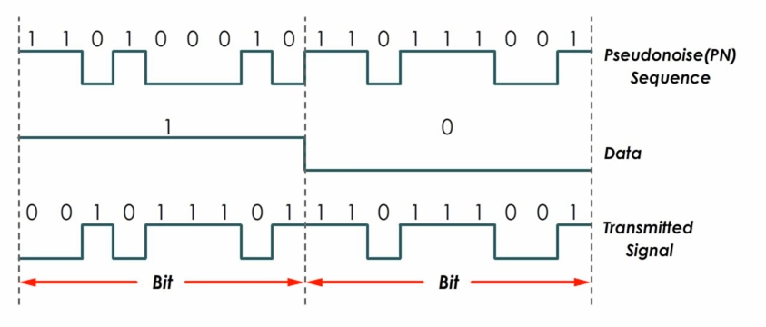
Direct-sequence Spread Spectrum(DSSS)
DSSS encode data signals directly with a higher bit rate sequence.
Fig. 1. DSSS encode [3]
PN code consists of a radios pulse that is much shorter in duration than the original message signals. The smaller this duration, the larger the bandwidth of the resulting DSSS signals.
Notes:
Benefits:
More bandwidth is used.
Data are encoded.
Low power density and noise-like signals are harder to detected and interfered.

Slide 4
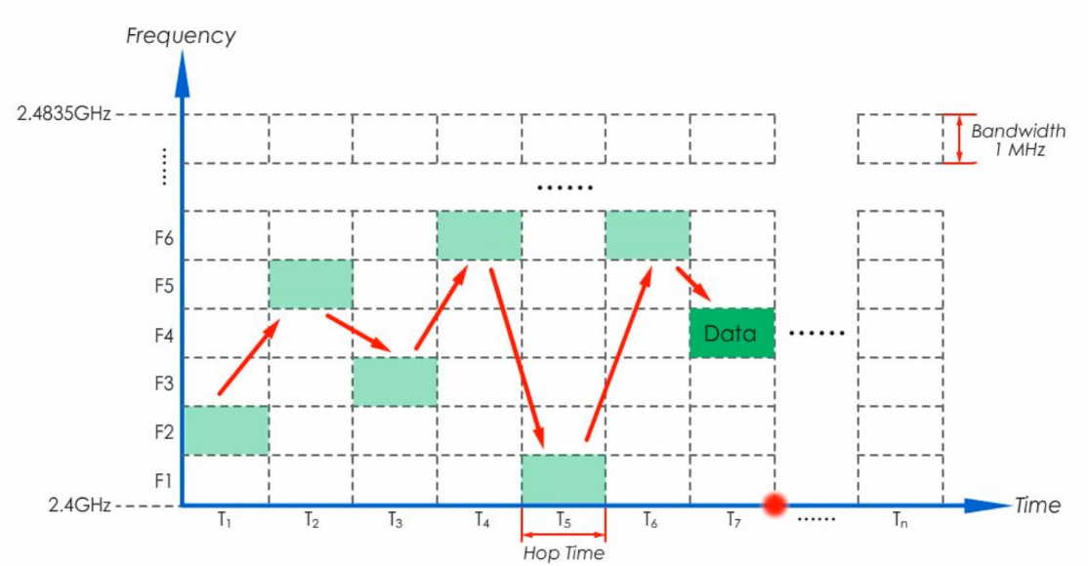
Frequency-hopping Spread Spectrum(FHSS)
The data signals hopping up and down to multiple different channels.
Sends data on one frequency at a time, and uses different frequencies over time.
The hopping pattern is known only between receiver and transmitter.
Fig. 2. FHSS [4]
Notes:
IEEE 802.11
A signal generated with a particular bandwidth is deliberately spread within the frequency band.

Slide 5
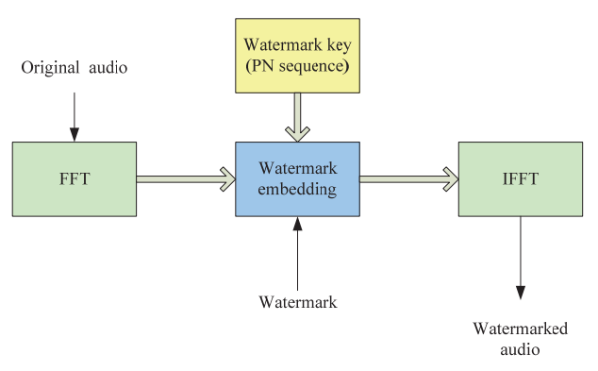
Spread Spectrum in Steganography
The message is transmitted through noiselike wave. This method can be applied to embed messages in audio data.
A key is needed to embed messages into noise, this key is used to generate pseudo-random key sequence.
Watermarking
Fig. 3. Basic embedding scheme [1]
Notes:
Spread Spectrum in Steganography

Slide 6
Chi-square Test
A statistical hypothesis test.
Formula for calculating Obtained Value
Parameters for finding Critical (expected) Value
Degrees of Freedom (df，自由度)
The significance level(α)
Table of Critical Values
Two purposes
Independence
df＝(r-1)(c-1)
Goodness of fit
df＝k-1
O: an obtained count of case i
E: an expected count of case i
Notes:
Chi-square Test

Slide 7
Chi-square Test Examples - Goodness of fit
Month | Count
1 | 190
2 | 152
3 | 121
4 | 110
5 | 147
6 | 199
7 | 250
8 | 247
9 | 201
10 | 150
11 | 193
12 | 212
Total | 2172
Critical (expected) Value
α＝0.05
df＝12－1＝11
Critical value＝19.675
Obtained Value
2172／12＝181
(190－181)^2／181＋(152－181)^2／181＋……＋(212－181)^2／181 ＝125.02
125.02＞19.675 → Reject

Slide 8
Crack Caesar Cipher with Chi-square Algorithm
Letter frequency
Steps
Count the obtained number of each letter in cipher text.
Calculate the number of expected number by letter frequency in English.
Calculate Obtained Value of Chi-square
Try in different cases and got the minimum Obtained Value
Example codes
Notes:
OLJHLZHYJPWOLYPZVULVMAOLLHYSPLZARUVDUHUKZPTWSLZAJPWOLYZPAPZHAFWLVMZBIZAPABAPVUJPWOLYPUDOPJOLHJOSLAALYPUAOLWSHPUALEAPZZOPMALKHJLYAHPUUBTILYVMWSHJLZKVDUAOLHSWOHILA

Slide 9
References
A. Anastasijević, D. Čoja and J. Ćertić, "Audio watermarking using frequency hopping method," 2011 19thTelecommunications Forum (TELFOR) Proceedings of Papers, 2011, pp. 1586-1589, doi: 10.1109/TELFOR.2011.6143863.
Malik, H. and Sandeep Singh Kang. “Designing and Evaluation of Performance of a Spread Spectrum Technique for Audio Steganography.” (2013).
Sunny Classroom, “DSSS - Direct Sequence Spread Spectrum” YouTube video, 6:40, Sep. 24, 2018.
Sunny Classroom, “FHSS - Frequency Hopping Spread Spectrum” YouTube video, 5:53, Sep. 22, 2018.
NIST/SEMATECH e-Handbook of Statistical Methods, “Critical Values of the Chi-Square Distribution”. (https://www.itl.nist.gov/div898/handbook/eda/section3/eda3674.htm)
IB Maths Resources from Intermathematics, “Using Chi Squared to Crack Codes”, June 15, 2014. (https://ibmathsresources.com/2014/06/15/using-chi-squared-to-crack-codes/)

